Slide 1
MILLIMETER WAVE SENSING FOR ANYTHING DETECTION
Superviser:
Margreta Kuijper
Sean Meng
Team member: Haohan Xu 1512074
Yuheng Li 1569107
Dongfang Lyu 1444967
16 June 2026
Notes:
Good afternoon everyone, and welcome to our Capstone presentation. Today, we are presenting our project on Millimeter Wave Sensing.

Slide 2
Content
Part 1 Introduction
Part 2 Overview
Part 3 Hardware and firmware Design
Part 4 Algorithm
Part 5 Mechanical Design
Part 6 Conclusion
Notes:
In this presentation, we will take you through our entire journey: starting with the problem we are solving, followed by our full-stack engineering solution covering hardware, firmware, DSP algorithms, and mechanical design.

Slide 3
Part 1 Introduction

Slide 4
Introduction
Accurately monitoring environmental factors and human health indicators without physical contact is crucial in fields such as industrial predictive maintenance, non wearable health tracking, and elderly care.
Traditional sensors
Contact/wearable: deployment difficulties, discomfort during prolonged wear, and privacy concerns.
Image Source: mindray medical device
Notes:
Let's start with the problem. Look at the screen—this is our ultimate vision.
Right now, traditional sensors must be taped to a patient's skin. But a newborn's skin is very fragile. Peeling off these sticky sensors every day causes real skin damage.
And it’s not just babies. Elderly patients hate wearing these devices. Also, using cameras in bedrooms raises huge privacy concerns.
This showed us a massive gap in the market. We need a system that is accurate, and completely contactless. That is the vision behind our project.

Slide 5
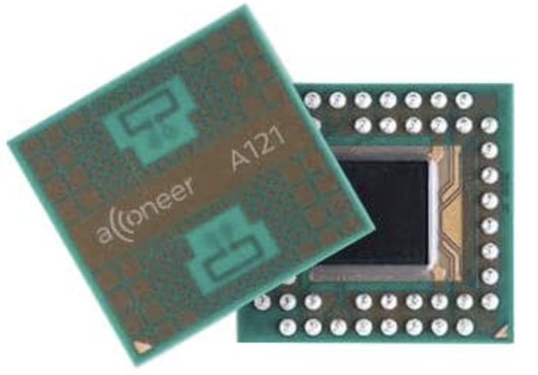
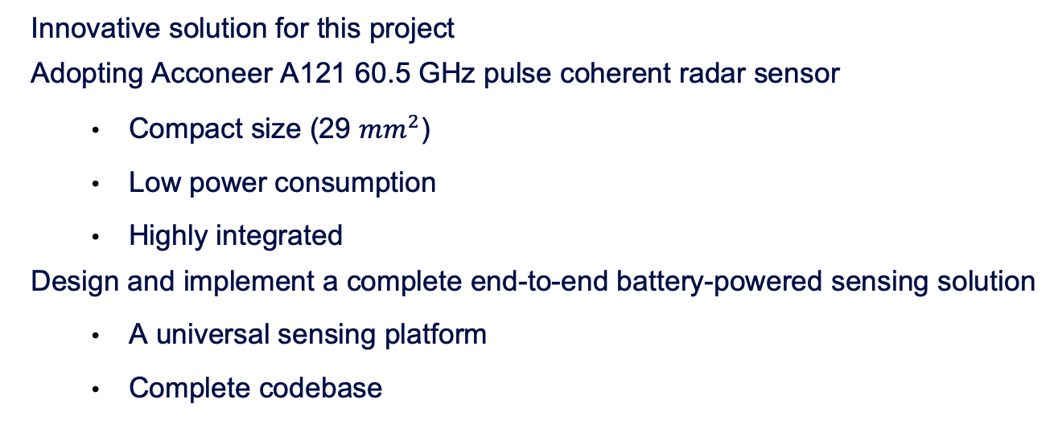
Introduction
Innovative solution for this project
Adopting Acconeer A121 60.5 GHz pulse coherent radar sensor
Compact size (29 $mm^{2}$)
Low power consumption
Highly integrated
Design and implement a complete end-to-end battery-powered sensing solution
A universal sensing platform
Complete codebase
Notes:
To build this, we chose the Acconeer A121 mmWave radar. As you can see, it is low-power and completely contactless.
But what's truly amazing is its compact size. It is a highly integrated chip. It packs the entire RF front-end—including the transmitter, receiver, amplifiers, mixers, and ADCs—all into one tiny package.
However, buying a great chip is easy. The real challenge is building the system around it. We designed a complete end-to-end solution from scratch.
And one key point: vital sign monitoring is just our demo. Our real achievement is the underlying platform.
Because we built a full-stack ecosystem, this exact same hardware can measure distance, speed, or even classify surfaces. So today, we are presenting a highly scalable, universal sensing platform.

Slide 6
Part 2 Overview

Slide 7
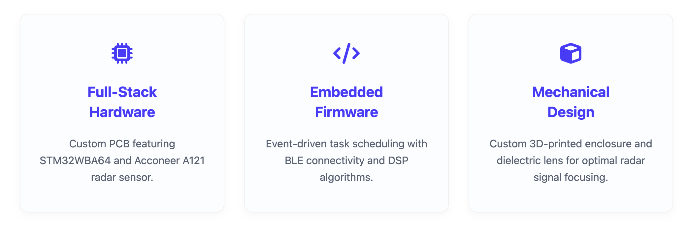
Overview

Slide 8
Part 3 Hardware and Firmware Design

Slide 9
Hardware Design Process
Risk driven design process
Uncertainty Risk: Design validity is unknown until the final power-on.
Debugging Risk: Hardware mistakes are extremely costly and time-consuming to fix.
Official documentation guided design process
Iterative design process
Make design as simple as possible but meet design specifications
Notes:
The biggest risk in hardware design is we don’t know whether our design is working or not until we actually complete the whole design cycle and power on the system.
Another big risk is hardware is difficult to debug. Even a small mistake made in design and soldering may require a large amount of time to debug.
Because the cost of hardware failure is so high, this naturally led us to adopt the following three design processes to mitigate these risks:
First, an Iterative Design Process. To eliminate the 'uncertainty risk', we didn't build a custom hardware on day one. We validated our idea on development boards first. Once we proved the concept worked, only then did we move to our custom hardware.”
Second, an Official Documentation Guided Design. To minimize 'debugging risks' like RF interference or power instability, we strictly followed the reference designs and layout guidelines provided by Acconeer and STMicroelectronics.
Overall, I think the ultimate goal in hardware design is
With these risk-mitigation philosophies in mind, let's look at how we actually executed our Hardware Design Flow in reality

Slide 10
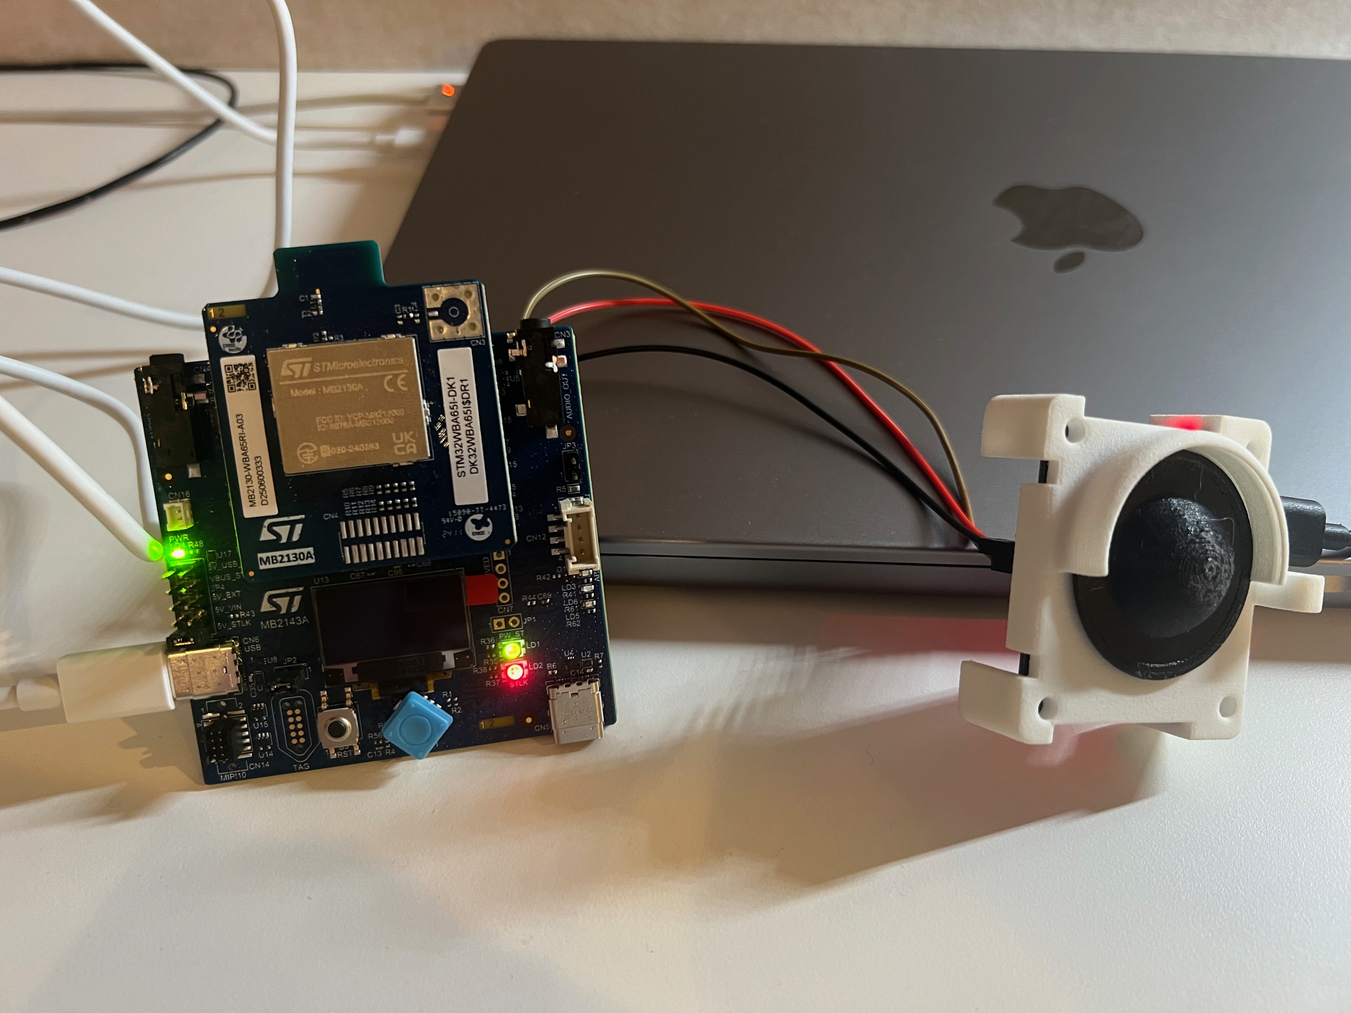
Hardware Design Flow
Development board evaluation
mmWave sensor development board (Acconeer XE125)
MCU with BLE development board (STM32WBA65I-DK1)
Build a first prototype using development boards
Component Selection
Core ICs: MCU and radar sensor
Power domain: voltage regulators, charging IC
Interface: USB connector, USB-UART converter, SWD debug header
Passive components: crystal, capacitor, resistor
Notes:
As mentioned in our iterative process, our first step was building a prototype using development boards. The main purpose to do this is to demonstrate the capability of hardware and to be familiar with the development environment
Then we moved to Phase 2: Component Selection. the biggest real-world risk we faced here was actually Component Availability (supply chain issues). For example, halfway through the design, the specific 1.8V voltage regulator we chose suddenly went out of stock.
The A121 mmWave radar has a very strict power requirement: when it wakes up from 'idle' to 'measure' state, it draws a sudden 100mA current spike. If the LDO's transient response isn't fast enough to handle this, the output voltage will drop below the operating threshold, causing system instability or even hardware damage
Because we strictly followed the design guidelines, we fully understood this transient requirement. This allowed us to quickly evaluate the datasheets of in-stock components and find a reliable replacement LDO with a fast enough transient response.
Due to the time limit, I won't detail reasoning behind every component selection, but I'm happy to discuss them in the Q&A.

Slide 11
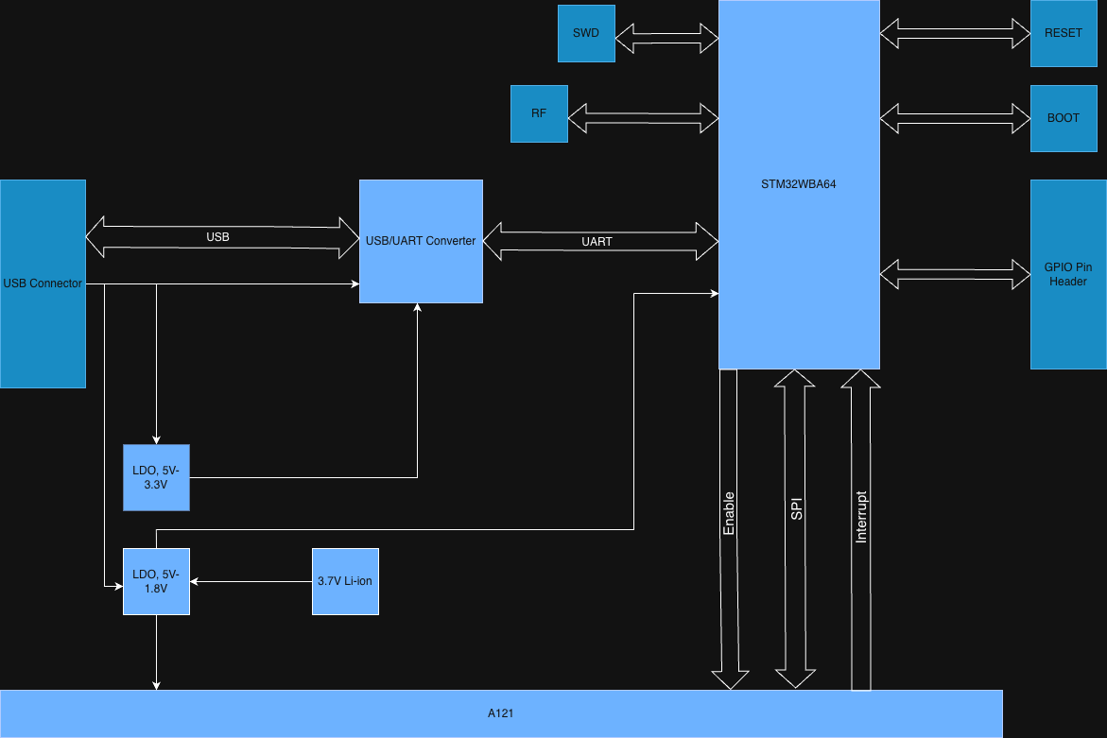
Hardware Architecture

Slide 12
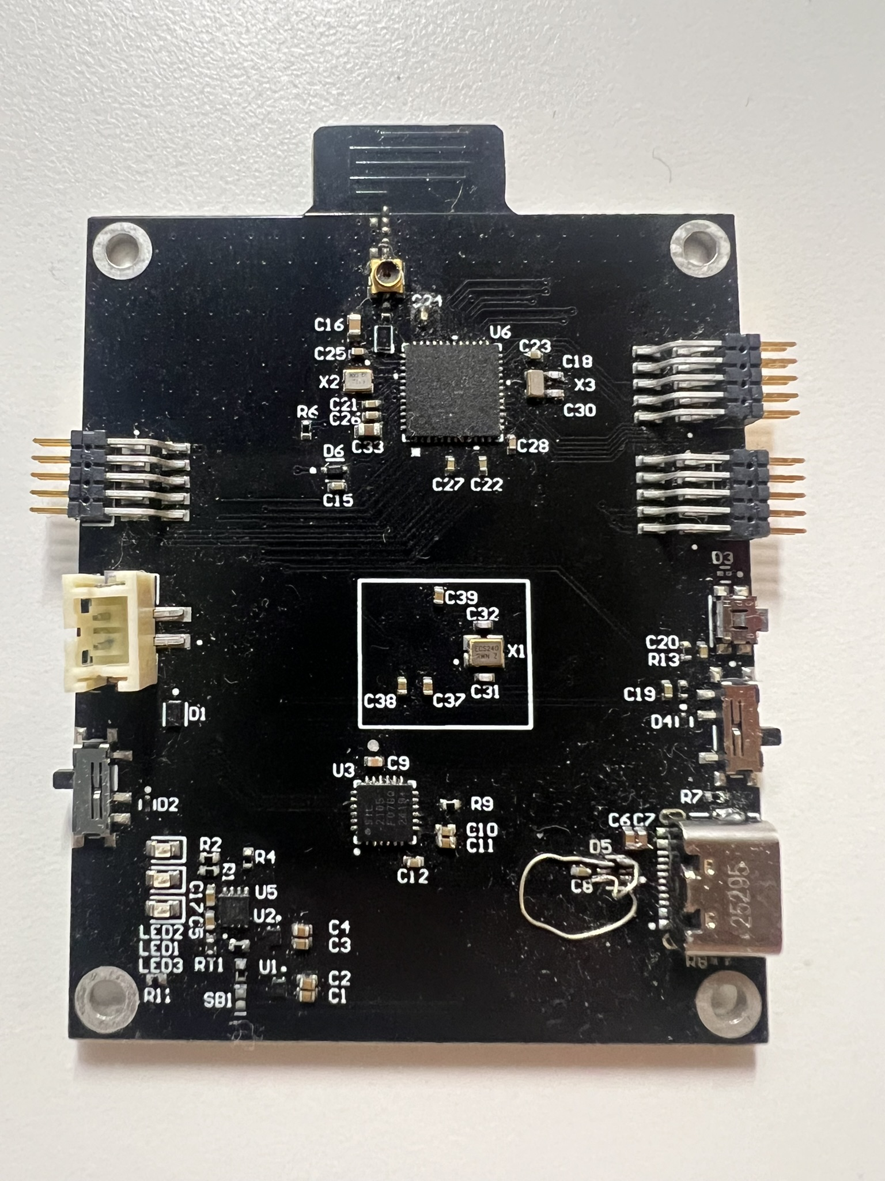
Hardware Design Flow
Schematic capture and verification
Layout and Design Rule Check
Production
Assembly
Test and debug
Notes:
After finalizing component selection, I moved into the actual hardware implementation phase, which includes schematic capture, PCB layout, manufacturing, assembly, and finally, testing and debugging.
To be honest, it's really hard to capture everything I did on one slide. I mean, you really have to go through the whole process—not just learning from a textbook, but learning from actual experience.
And as a result, here is a picture of the final physical board. I'm very proud to say that our very first hardware iteration successfully booted up and the core system worked perfectly on the first try.
There is only one minor mistake: we accidentally swapped the USB differential pair (D+ and D-) on the schematic. It didn't affect the radar or the BLE functionality at all, it just meant we couldn't get the USB debugger logs on our computer.

Slide 13
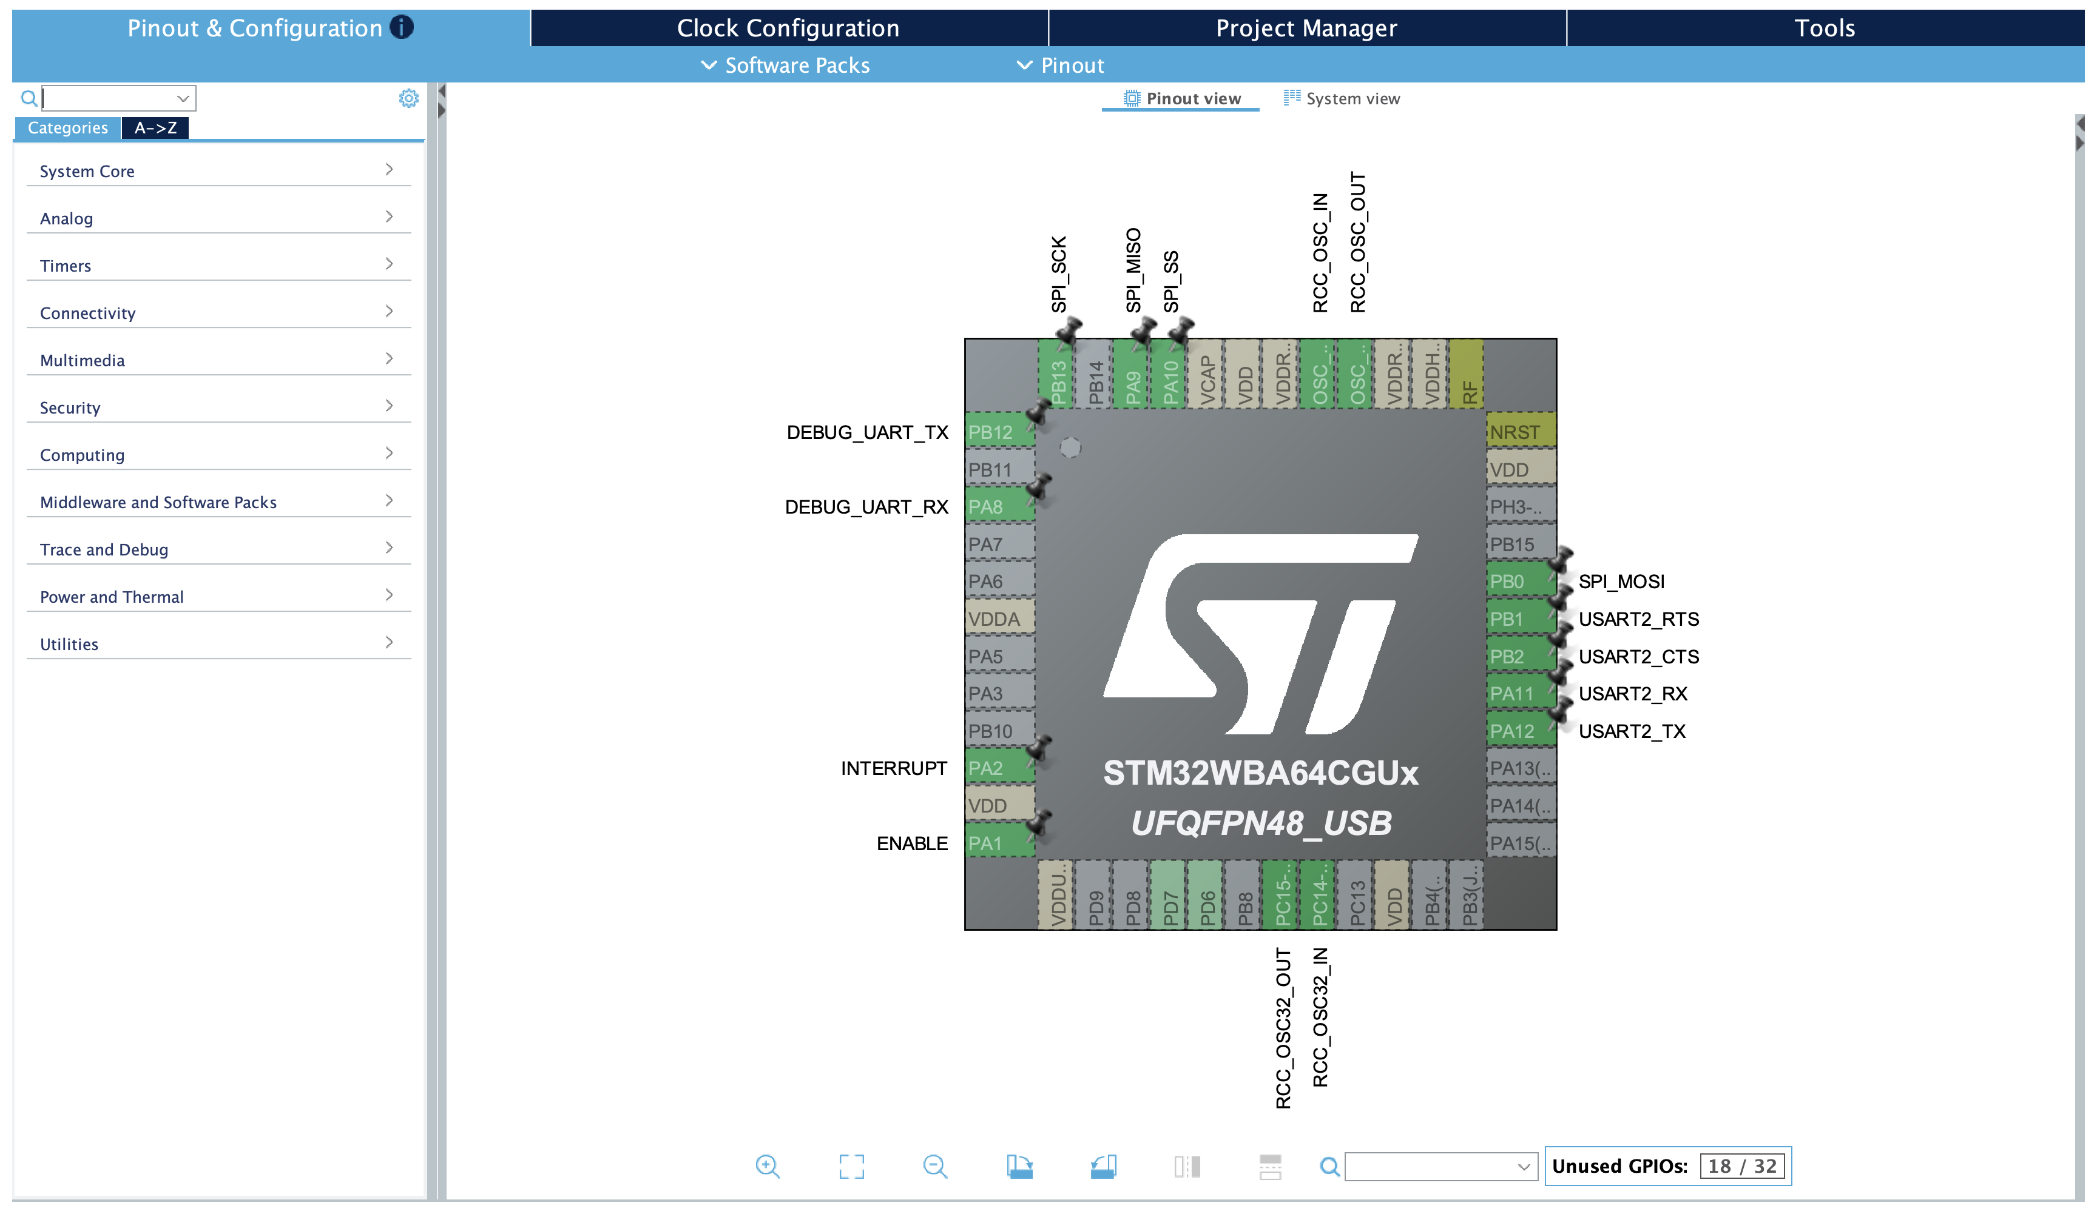
Firmware Design Process
Two Choices
Bare-metal programming
HAL (Hardware Abstraction Layer)
CubeMX Setup
Connectivity (SPI, UART)
System Core (DMA, Interrupt, …)
System Clock
BLE
…
BLE Configuration
Notes:
For our firmware architecture, we had to make a key decision: whether to use bare-metal programming or rely on ST's HAL, the Hardware Abstraction Layer.
While bare-metal gives you ultimate control, it requires a deep understanding of the MCU's internal architecture and registers. For this project with a limited time, that's a huge time risk.
So, we made the pragmatic decision to use the HAL library. Because it abstracts the low-level details, it provided us with clear, easy-to-use functions. This allowed us to focus our time on the actual application logic—like sensor processing and BLE communication—rather than getting stuck in register debugging.
Furthermore, we used STM32 CubeMX for our initial system setup. It allowed us to graphically configure the MCU and automatically generate the initialization code. This standard, official workflow speed up our development process and eliminated human errors in the early stages."

Slide 14
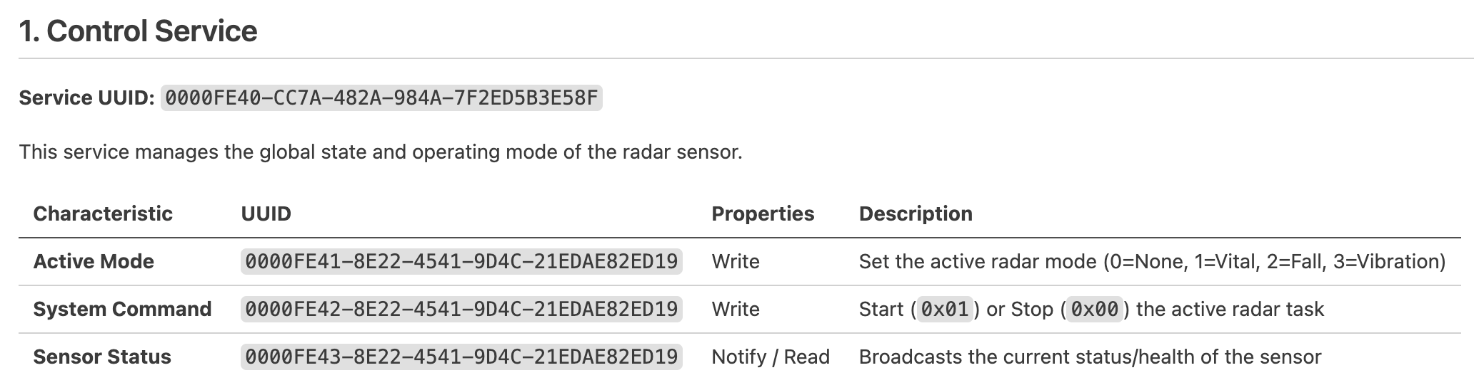
BLE Configuration
Start with official tutorial then adapt to our application
Low level details about BLE protocol are handled by ST’s middleware
Custom GATT Server: BLE services and characteristics
Four services (control, vital sign, fall, vibration)
Several characteristics are defined for each service
Notes:
Now let's talk about the BLE data transmission. BLE protocol is another big topic, but instead of going through all the details and writing the low-level stack from scratch, we utilized ST's BLE middleware. This allowed us to focus on what really matters: the Application Layer architecture.
Because our radar generates very specific data, the standard official BLE profiles (like the basic Heart Device profile) were not enough for us. So, we designed a completely custom GATT server. GATT stands for Generic Attribute Profile. In the Bluetooth specification, it defines the exact protocol for how two BLE devices transfer data back and forth using a strict hierarchy.
To make the data organized and easily readable by the phone app, we categorized our data into 4 custom Services. You can think of a Service like a category on a restaurant menu. Under each Service, we defined specific Characteristics, which act like the individual dishes on the menu.
By designing these 4 custom Services, we created a very clean, structured 'API' between our hardware and the mobile app."

Slide 15
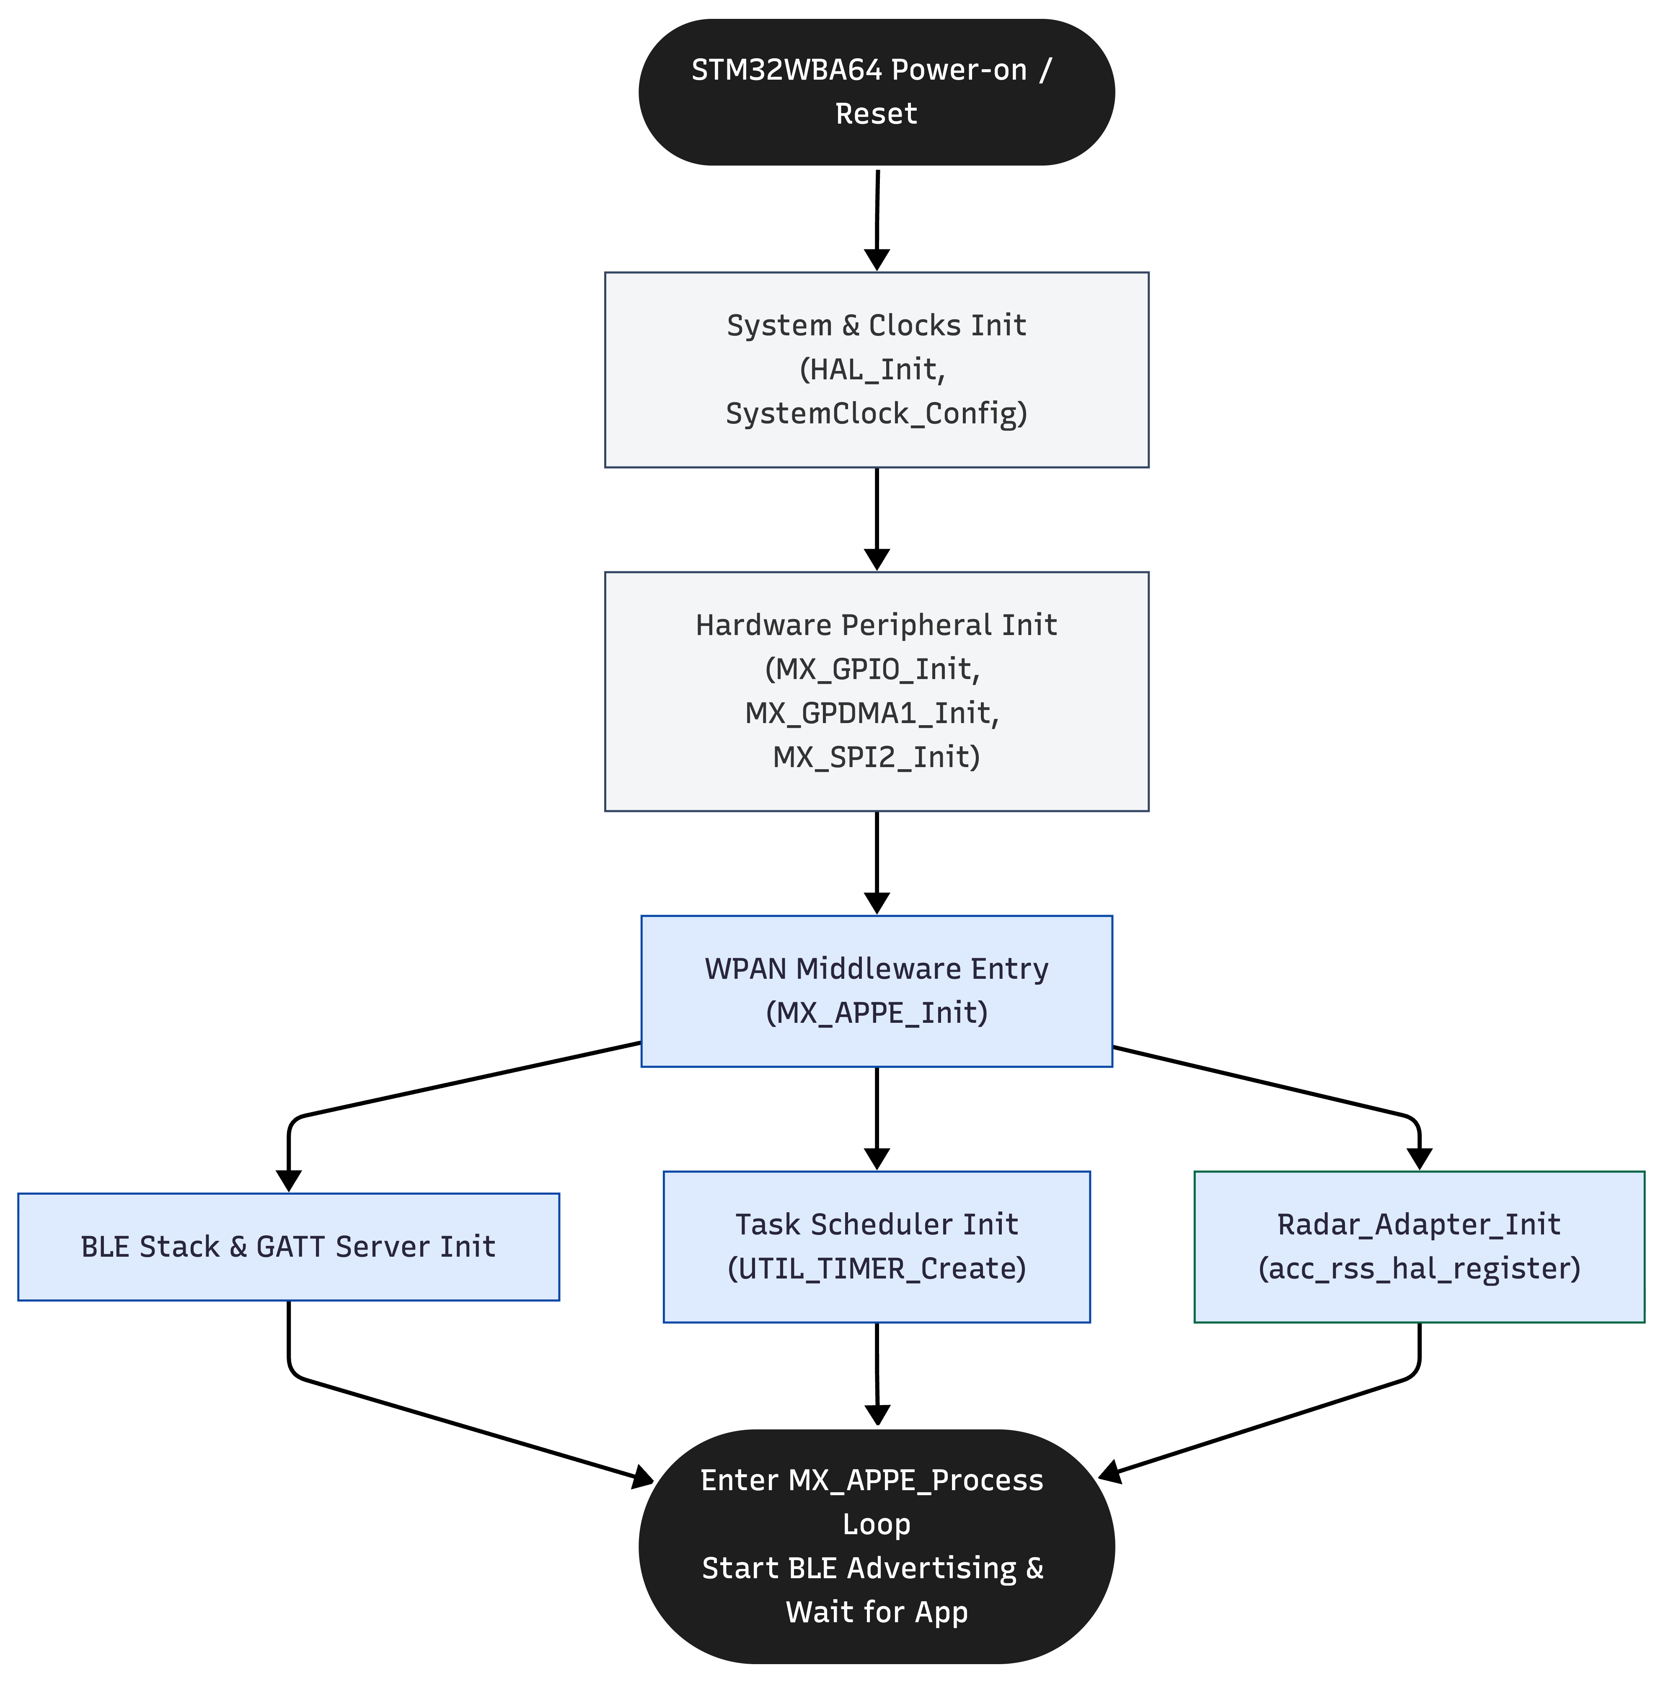
Firmware Architecture
Hardware Initialization
Middleware Initialization
STM32 firmware boot sequence executing within main.c
Notes:
This flowchart shows our firmware boot sequence inside main.c. Instead of reading every function, I want to highlight the architectural logic behind this sequence.
The boot process strictly follows a 'Hardware First, Middleware Second' dependency order. Before we touch any complex BLE protocols or radar process, we must secure the foundation. So, the system clocks, GPIOs, DMA, and the SPI bus for the radar are initialized first.
Once the hardware layer is stable, we enter the WPAN Middleware initialization. Three processes are set up: the BLE GATT server, the internal task scheduler, and the Radar Adapter registration.
Finally, everything converges into the MX_APPE_Process loop. This is not just a simple while-loop; it's an event-driven architecture. It starts the BLE advertising and puts the system into a low-power wait state until the mobile app connects and triggers the radar measurement.

Slide 16
System Integration
radar_adaptor.c as the main control hub to coordinate BLE and sensor tasks
Wrap low level functions in A121 SDK into several functions (APIs)
bool Radar_Adapter_Init(void);
bool Radar_Adapter_Start(Radar_Mode_t mode);
static bool init_vibration(void);
static bool init_presence(void);
bool Radar_Adapter_Process(Radar_Mode_t mode);
void Radar_Adapter_Stop(void);
static bool do_sensor_calibration_and_prepare(…);
Notes:
Now we have hardware, firmware and algorithm ready, but they are still separate pieces, to wire them up, we need to do system integration
Inside it, We wrapped the low-level functions of the Acconeer SDK into a few clean, high-level APIs.
Let me give you a real-world example of how this ties everything together. When a user is on vital sign page and presses the 'Start Measure' button, the phone sends a BLE command. Our GATT server receives this command, but the BLE stack doesn't need to know anything about how the radar works. It simply calls this function: Radar_Adapter_Start(), based on the input argument, it will call init_presence to initialize the radar, after this, radar_adaptor process will take over and start taking measurement and doing all signal processing tasks.
Now my teammate will explain the actual signal processing algorithm inside that Radar_Adaptor_Process function

Slide 17
Part 4 Algorithm

Slide 18
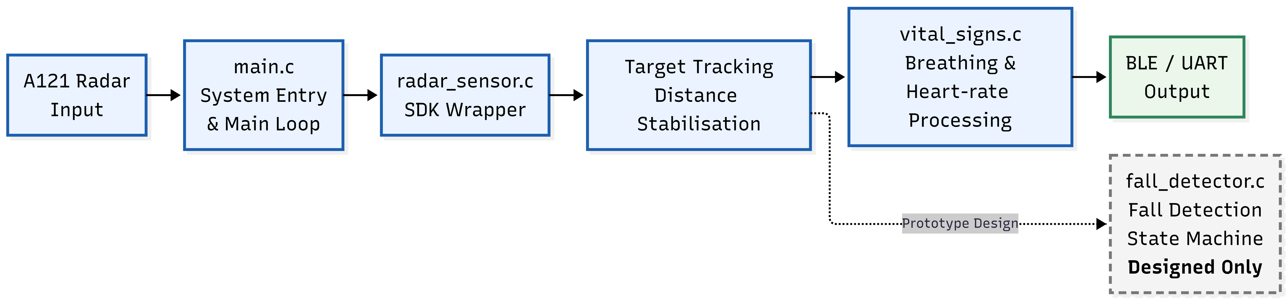
Code Scope and Module Structure
Section Scope
This section focuses on embedded firmware and algorithm-level implementation.
The main implemented modules include radar data acquisition, target tracking, vital-sign processing, and output handling.
Hardware design, lens design, and mobile UI are covered in other sections.
Fall detection is included only as a designed state-machine prototype, not as a fully validated final function.

Slide 19
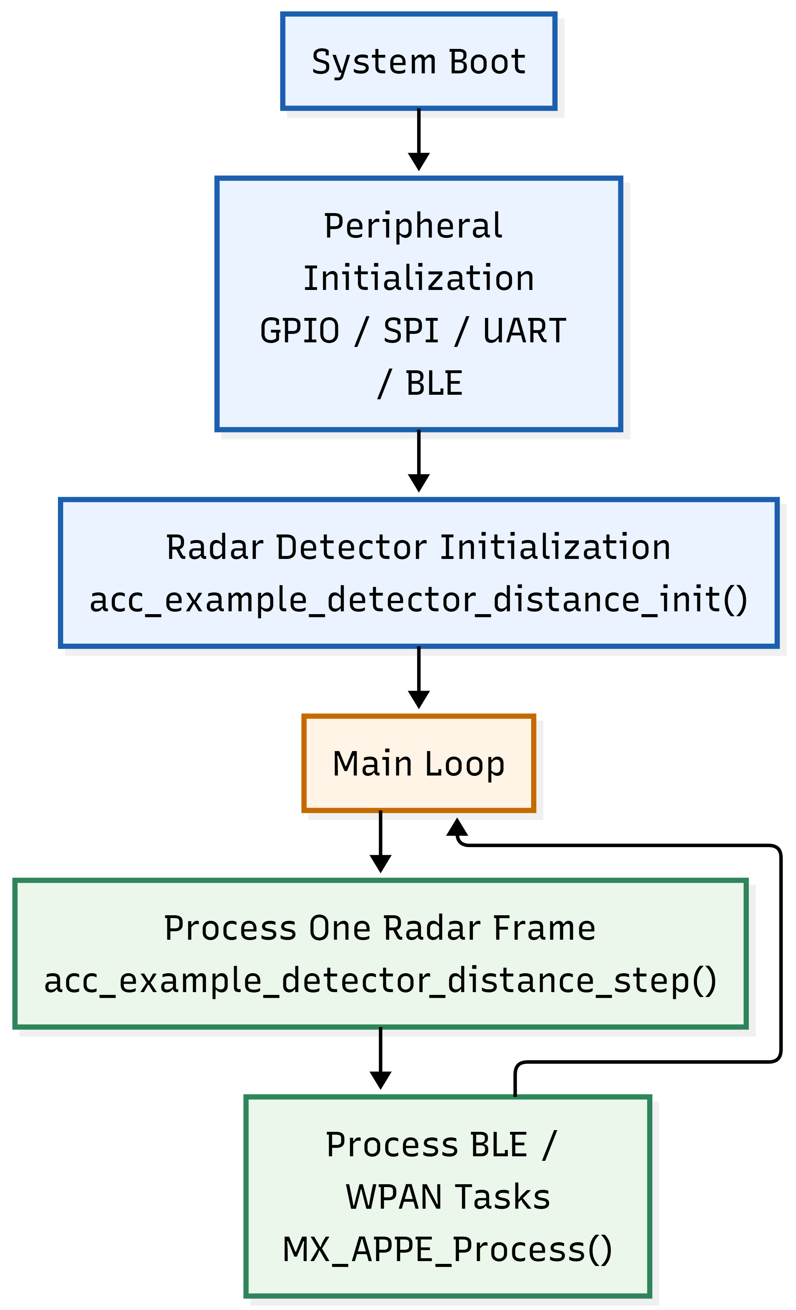
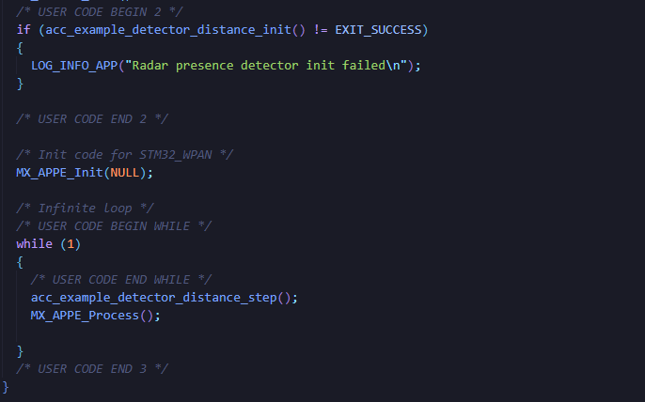
Main Loop and Real-time Execution
Main Loop Design
Initialize radar detector once at start-up
Process one radar frame per loop iteration
Run BLE / WPAN task processing in the same loop
Avoids a blocking radar-only execution flow

Slide 20
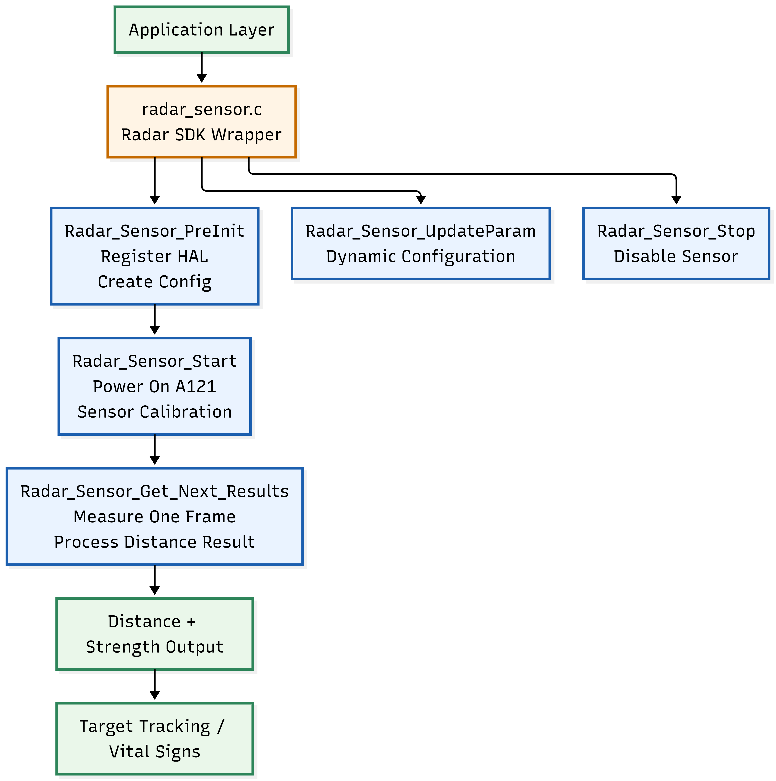
Radar SDK Wrapper
Key Functions
Radar_Sensor_PreInit()
registers HAL and creates detector resources
Radar_Sensor_Start()
powers on A121 and runs calibration
Radar_Sensor_Get_Next_Results()
measures one frame and returns distance results
Radar_Sensor_UpdateParam()
updates radar configuration parameters
Radar_Sensor_Stop()
disables the sensor and stops measurement
Radar SDK Wrapper
Wraps Acconeer A121 distance detector into reusable firmware functions
Handles HAL registration, sensor configuration, calibration, and measurement
Separates low-level SDK calls from application-level processing
Provides stable distance and signal-strength outputs for later modules

Slide 21
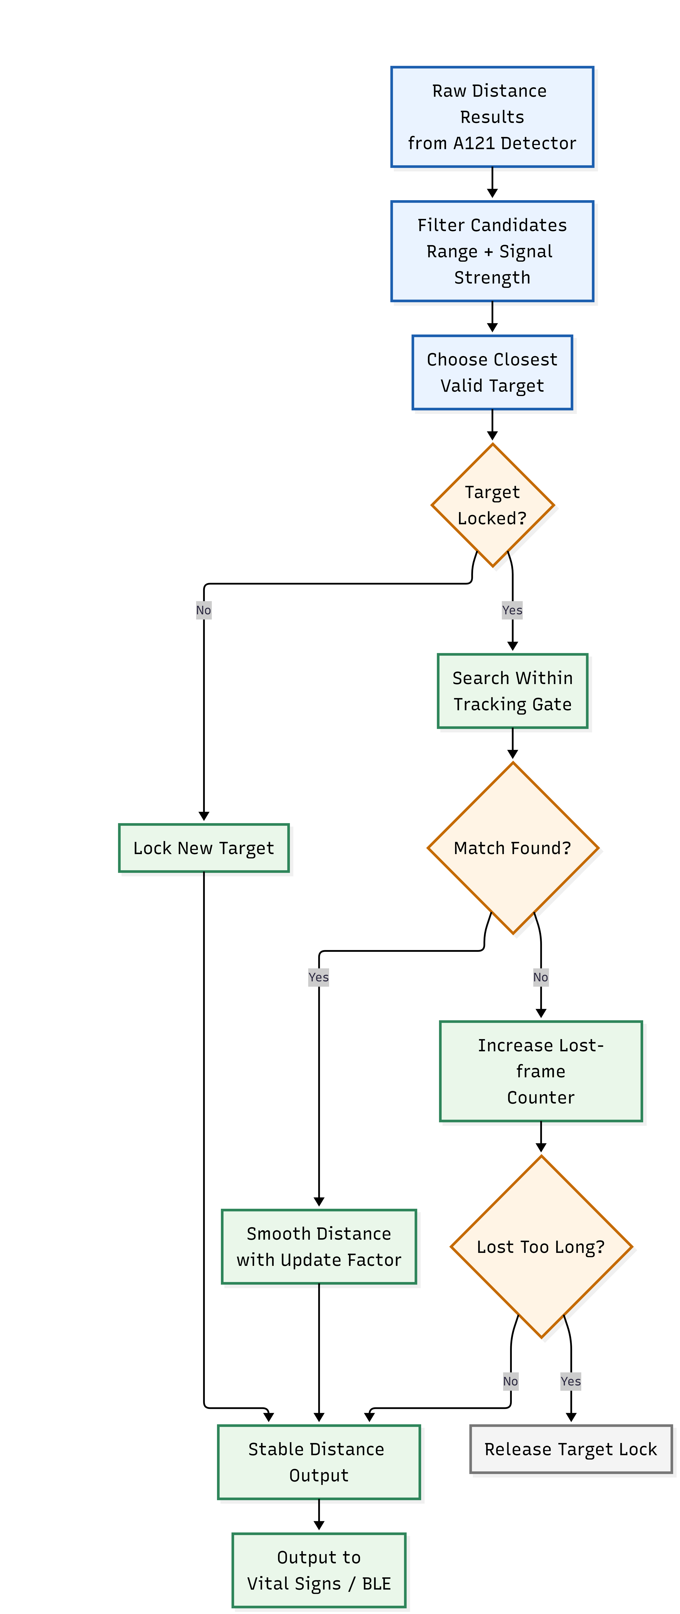
Target Tracking Filter
Tracking Logic
Filter raw distance results by valid range and signal strength
Select the closest valid target as the main subject
Lock the target and search within a tracking gate
Smooth the distance output using an update factor
Release the lock if the target is lost for several frames
Key Parameters：
track_min_dist
track_max_dist
track_strength_thr
track_gate
track_alpha
track_max_lost_frames

Slide 22
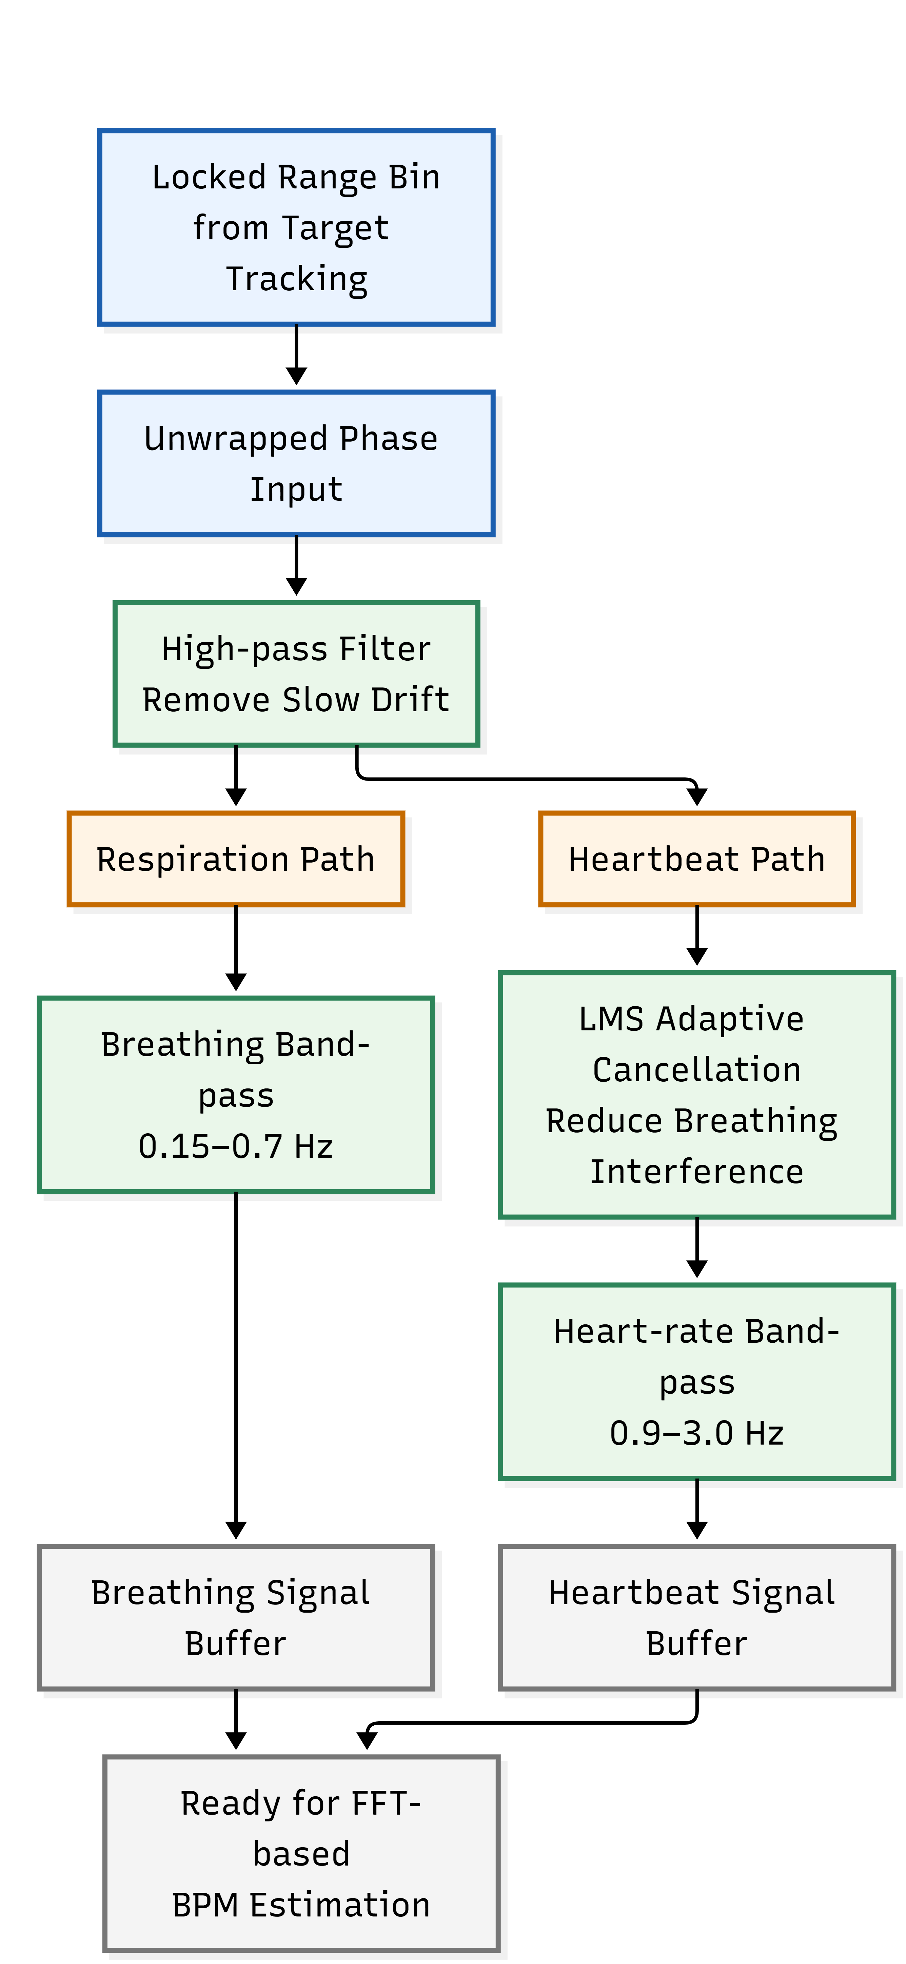
Vital Signs Processing Pipeline
Processing Logic
Uses unwrapped phase from the locked range bin as input
Applies high-pass filtering to remove slow drift
Separates respiration and heartbeat into different frequency bands
Uses LMS adaptive cancellation to reduce breathing interference
Stores filtered samples for later FFT-based BPM estimation

Slide 23
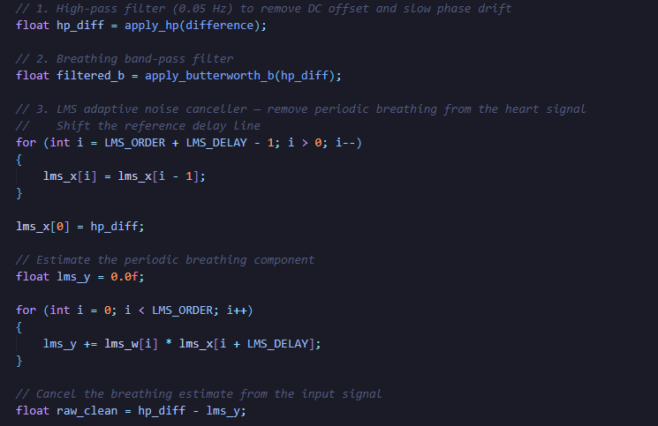
Vital Signs Processing Pipeline
Vital Signs Processing Code
This code processes the unwrapped phase signal
from the locked radar range bin.
apply_hp() removes slow drift and DC offset from the phase signal.
apply_butterworth_b() extracts the respiration component in the lower frequency band.
LMS adaptive cancellation is used to reduce breathing interference before heart-rate extraction.
apply_butterworth_h() extracts the heartbeat component in the higher frequency band.
The filtered signals are stored for later FFT-based BPM estimation.

Slide 24
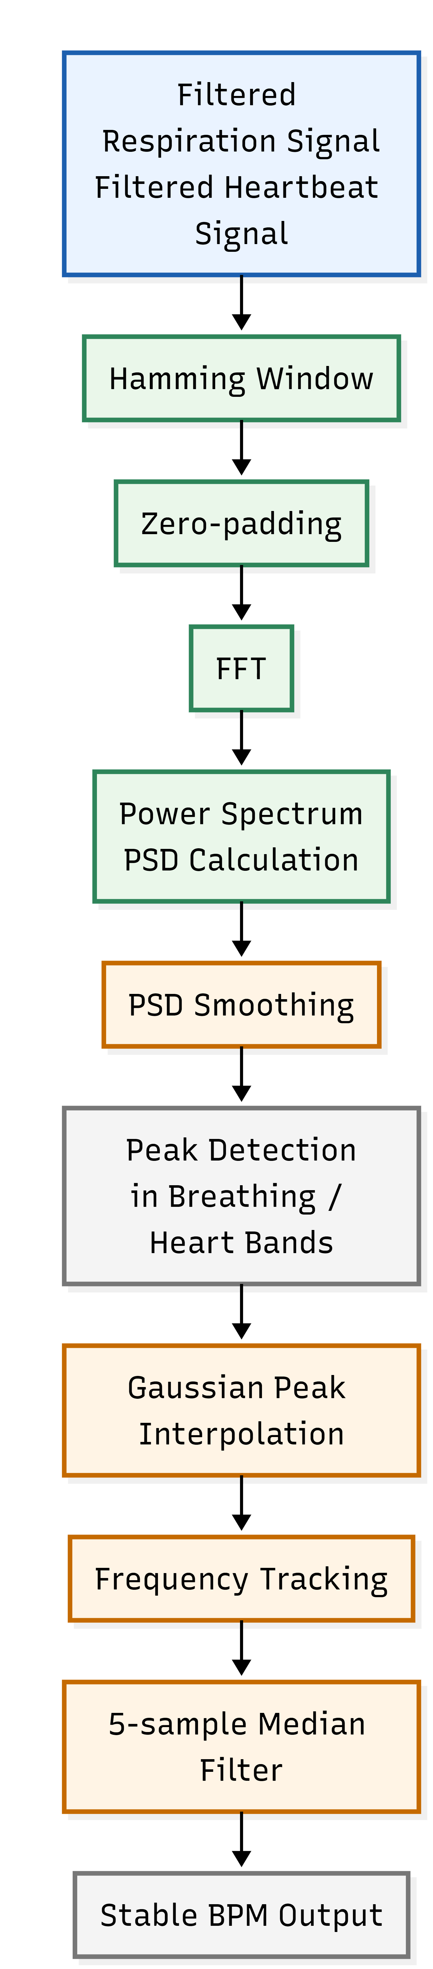
FFT and Output Stabilisation
Output Stabilisation
Apply Hamming window before FFT to reduce spectral leakage
Use zero-padding to improve frequency resolution
Smooth PSD values to reduce frame-to-frame noise
Use Gaussian peak interpolation for more accurate peak frequency estimation
Apply frequency tracking and 5-sample median filtering to stabilise BPM output

Slide 25
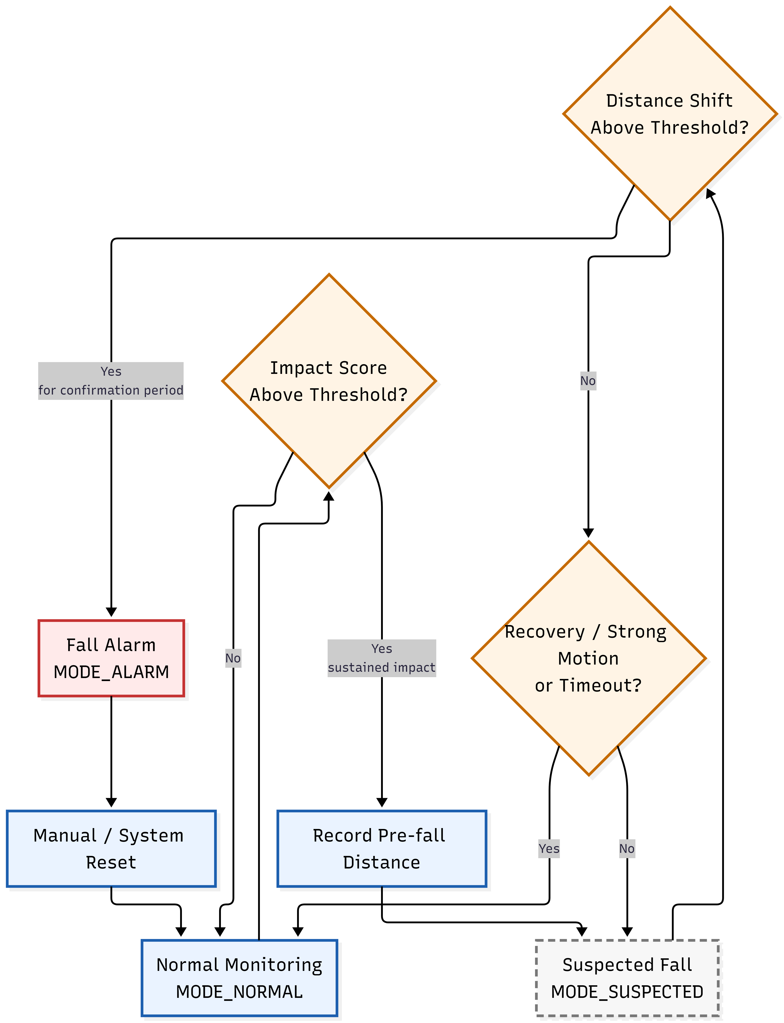
Fall Detection Design
Design Logic（Prototype only）
Detect a possible fall using motion intensity
Store the pre-fall subject distance
Enter a suspected state after sustained impact
Confirm a fall if the subject remains displaced for a set period
Cancel the suspected state if the subject recovers, moves strongly, or times out

Slide 26
Code Contribution Summary
Implemented Contributions
Built the main firmware execution flow
Integrated radar frame processing with BLE / WPAN task handling
Wrapped Acconeer A121 SDK functions into a reusable radar control layer
Added target tracking to stabilise distance outputs
Implemented phase-based vital-sign signal processing
Converted filtered signals into stable breathing-rate and heart-rate estimates
Prototype / Future Work
Fall detection was designed as a state-machine prototype
Full integration with the final sensing workflow was not completed
Experimental validation of fall detection remains future work
Further optimisation is needed for motion artefacts and real-world robustness

Slide 27
Part 5 Mechanical Design

Slide 28
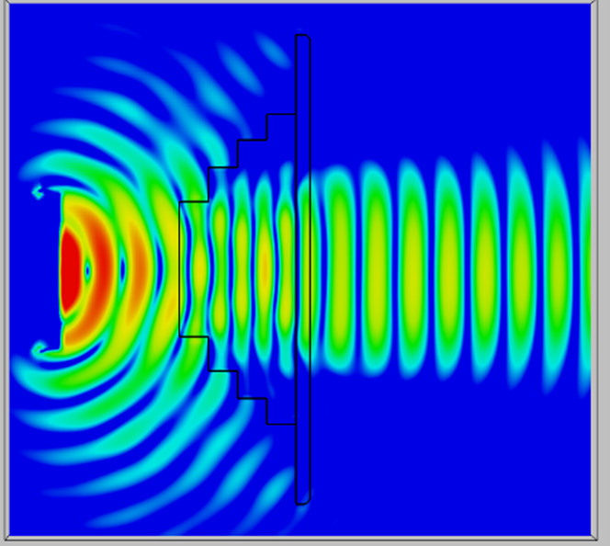
Beyond Protection
Geometric structure directly affects electromagnetic focusing characteristics
Goal: Improve antenna directionality+enhance received signal strength
From: Lens design — Acconeer docs

Slide 29
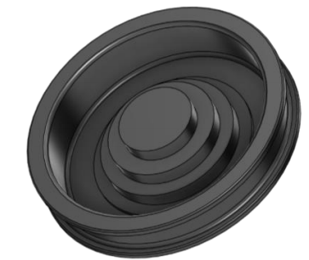
Fresnel Zone Plate (FZP)
FZP: Ladder structure, thickness does not increase with radius
Traditional lenses: thicker with larger aperture → Injection defects (shrinkage marks)
FZP advantages: flat, easy to manufacture, suitable for compact equipment

Slide 30






Theoretical Design
Center frequency of 60 GHz Material: PLA
Free-Space Wavelength Equivalent relative dielectric constant
Wavelength in Medium
Initial Focal Length
Design Diameter
Ratio traditional design rate: 0.3~0.6

Slide 31

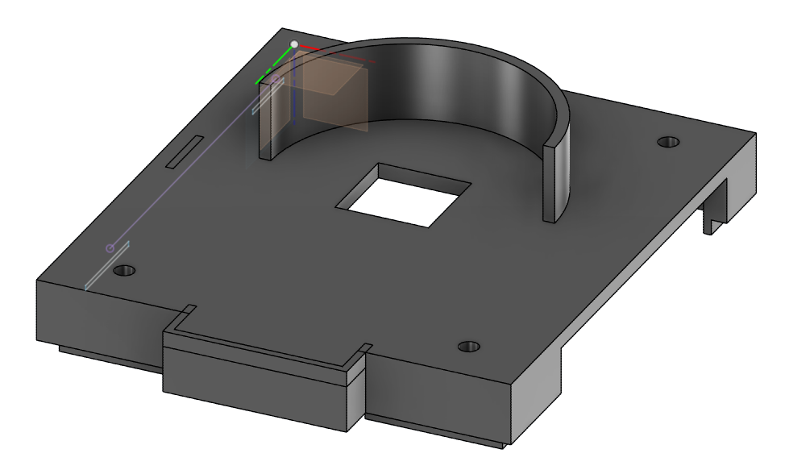

From Theory to Experiment
Affected by standing waves:
Experimental optimal air gap: 6 mm 3.5 mm
Total thickness of the 4-layer steps
Physical testing is still required,
as long slots without fixed points were used

Slide 32
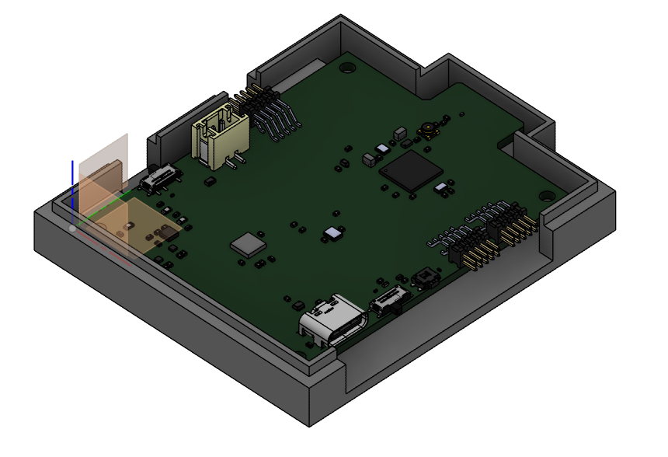
Mechanical Integration & Assembly
Parametric CAD Modeling
Lens-to-sensor spacing defined as adjustable parameter
Enables rapid iteration while maintaining dimensional consistency
Critical for optimizing beam focusing characteristics at 60 GHz
Interference Check
Import completed PCB STEP model into CAD environment
Verify clearance between housing and all components before manufacturing
Reduces mechanical integration errors and accelerates prototyping
Final Assembly
FZP lens integrated with 3D-printed housing
A121 radar module and PCB precisely positioned
Compact form factor suitable for portable healthcare applications

Slide 33
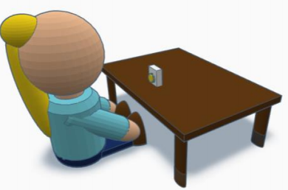
Material Trade-off: PA12 vs PLA
PA12:
εr ≈ 2.6
Ultra-low loss (<0.005)
Sharp focusing
Tough, high temp stable
PLA:
εr ≈ 2.6 (effective)
Higher loss (0.01–0.02)
Beam broadening
Brittle, Tg~60°C
It seems that PA12 is all about advantages
However, some characteristics of PLA are in line with our needs
Heart Rate!

Slide 34
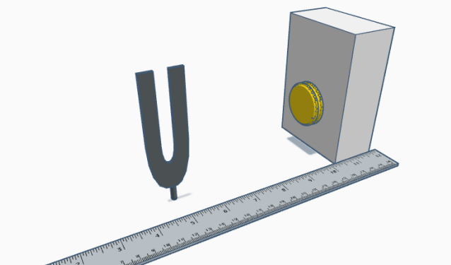
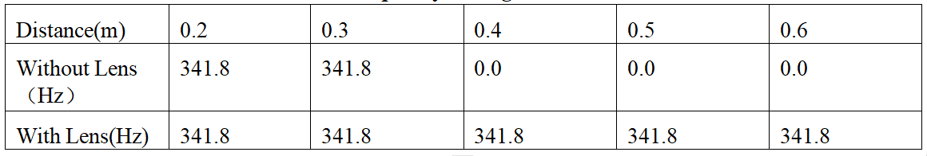
Lens Impact
Test signal: 341.3 Hz tuning fork
Target alignment: Rigidly clamped at fixed height, perfectly aligned with radar line-of-sight
Metric: Maximum reliable detection distance
Improvement: +100%

Slide 35
Part 6 Results & Conclusion

Slide 36
Conclusion
Core Achievement:
Full-Stack Integration: Successful development of an end-to-end 60 GHz mmWave radar platform (Hardware, Firmware, and iOS App).
Ultra-Low Power: Achieved < 1 µA idle current through hardware power gating and RTOS-based task scheduling.
High-Precision DSP: Validated multiple sensing modes
Range Enhancement: Doubled the stable sensing distance (from 0.3m to 0.6m) using a custom 3D-printed FZP dielectric lens.

Slide 37
Conclusion
Core Achievement:
Full-Stack Integration: Successful development of an end-to-end 60 GHz mmWave radar platform (Hardware, Firmware, and iOS App).
High-Precision DSP: Validated multiple sensing modes
Range Enhancement: Doubled the stable sensing distance (from 0.3m to 0.6m) using a custom 3D-printed FZP dielectric lens.

Slide 38
Future Directions
Further improve the fall algorithm and enhance its functionality to enable use in regular indoor environments
Use chips with more transmission and reception capabilities, or connect multiple chips in parallel, to enable detection of multiple objects
Optimize the casing to achieve practicality and aesthetics, and design corresponding lenses based on the above expansion scenarios

Slide 39
References
Acconeer AB. (n.d.). A121 - Pulsed coherent radar (PCR) datasheet (v1.8). Retrieved from
https://developer.acconeer.com/
Acconeer AB. (n.d.). Entry+ module EVK hardware user guide - XE125. Retrieved from
https://developer.acconeer.com/
Acconeer AB. (n.d.). Entry+ module XM125 datasheet (v1.2). Retrieved from https://developer.acconeer.com/
Acconeer AB. (n.d.). Hardware and physical integration guideline PCR sensors A111 & A121. Retrieved from
https://developer.acconeer.com/
Acconeer AB. (n.d.). XM125 software user guide. Retrieved from https://developer.acconeer.com/
Onsemi. (n.d.). NCP167 700 mA, ultra-low noise and high PSRR LDO regulator datasheet. Retrieved from
https://www.onsemi.com/
Silicon Laboratories. (n.d.). CP2105 single-chip USB to dual UART bridge datasheet. Retrieved from
https://www.silabs.com/
STMicroelectronics. (2025). STM32WBA6xxx datasheet (DS14736 Rev 3). Retrieved from https://www.st.com/
STMicroelectronics. (n.d.). AN5042 application note: How to calibrate the HSE clock for RF applications on
STM32 wireless MCUs. Retrieved from https://www.st.com/

Slide 40
References
STMicroelectronics. (n.d.). AN5948 application note: How to develop RF hardware using STM32WBA MCUs.
Retrieved from https://www.st.com/
STMicroelectronics. (n.d.). MLPF-WB-04D3: 2.4 GHz low pass filter matched to STM32WB datasheet.
Retrieved from https://www.st.com/
STMicroelectronics. (n.d.). RM0515 reference manual: STM32WBA6xxx advanced Arm®-based 32-bit MCUs.
Retrieved from https://www.st.com/
Texas Instruments. (n.d.). BQ25176 800-mA linear battery charger datasheet. Retrieved from
https://www.ti.com/
Hu, H., Huang, H., Li, M., Gao, X., Yin, L., Qi, R., Wu, R. S., Chen, X., Ma, Y., Shi, K., Li, C., Maus, T. M.,
Huang, B. K., Lu, C., Lin, M., Zhou, S., Lou, Z., Gu, Y., Chen, Y., ... Xu, S. (2023). A wearable cardiac
ultrasound imager. Nature. https://doi.org/10.1038/s41586-022-05498-z
Ikram, M. Z., Ahmad, A., & Wang, D. (2018). High-accuracy distance measurement using millimeter-wave
radar.
Kenny, J. S. (2024). Wearable ultrasound for continuous deep-tissue monitoring. Nature Biotechnology.
https://doi.org/10.1038/s41587-023-02098-8
La, T., & Le, L. H. (2022). Flexible and wearable ultrasound device for medical applications: A review on
materials, structural designs, and current challenges. Advanced Materials Technologies.
https://doi.org/10.1002/admt.202100798

Slide 41
References
Lin, M., Zhang, Z., Gao, X., Bian, Y., Wu, R. S., Park, G., Lou, Z., Zhang, Z., Xu, X., Chen, X., Kang, A.,
Yang, X., Yue, W., Yin, L., Wang, C., Qi, B., Zhou, S., Hu, H., Huang, H., ... Xu, S. (2023). A fully integrated
wearable ultrasound system to monitor deep tissues in moving subjects. Nature Biotechnology.
https://doi.org/10.1038/s41587-023-01800-0
Pietrangelo, S. J., Lee, H., & Sodini, C. G. (2018). A wearable transcranial Doppler ultrasound phased array
system. Acta Neurochirurgica. Supplement. https://doi.org/10.1007/978-3-319-65798-1_24
Steinberg, S., Huang, A., Ono, Y., & Rajan, S. (2022). Continuous artery monitoring using a flexible and
wearable single-element ultrasonic sensor. IEEE Instrumentation & Measurement Magazine.
https://doi.org/10.1109/MIM.2022.9720952
Thainthadaphat, P., Leeprechanon, N., Chandarasupsang, T., & Tananchana, A. (2026). Regulatory pathways for
smarter and flexible electricity network in Thailand: Enabling flexibility through DSO development. The
Electricity Journal. https://doi.org/10.1016/j.tej.2026.107544
Vostrikov, S., Ingolfsson, T. M., Hafthorsdottir, S., Leitner, C., Magno, M., Benini, L., & Cossettini, A. (2023).
A muscle pennation angle estimation framework from raw ultrasound data for wearable biomedical
instrumentation. IEEE Transactions on Instrumentation and Measurement.
https://doi.org/10.1109/TIM.2023.3335535
Wang, F., Jin, P., Feng, Y., Fu, J., Wang, P., Liu, X., Zhang, Y., Ma, Y., Yang, Y., Yang, A., & Feng, X. (2021).
Flexible Doppler ultrasound device for the monitoring of blood flow velocity. Science Advances.
https://doi.org/10.1126/sciadv.abi9283

Slide 42
References
Yang, X., Yan, J., Fang, Y., Zhou, D., & Liu, H. (2020). Simultaneous prediction of wrist/hand motion via
wearable ultrasound sensing. IEEE Transactions on Neural Systems and Rehabilitation Engineering.
https://doi.org/10.1109/TNSRE.2020.2977908
Yin, Z., Chen, H., Yang, X., Liu, Y., Zhang, N., Meng, J., & Liu, H. (2022). A wearable ultrasound interface for
prosthetic hand control. IEEE Journal of Biomedical and Health Informatics.
https://doi.org/10.1109/JBHI.2022.3203084
Acconeer. (2024, December 3). Product brief CH125 40 conical horn antenna. Acconeer Developer.
https://developer.acconeer.com/download/product-brief-ch125-40-conical-horn-antenna/?tmstv=1780049598
Acconeer. (2024, February 17). Getting started guide A121 lenses: LH112/120/132/122 . Acconeer Developer.
https://developer.acconeer.com/download/getting-started-guide-a121-lenses/?tmstv=1780049598
Acconeer. (2024, February 17). LH112 LH120 LH132 LH122 3D STEP. Acconeer Developer.
https://developer.acconeer.com/download/lh112_lh120_lh132_lh122-3d-step/?tmstv=1780049598

Slide 43
Thank you for listening

